Slide 1

Hospital Management System DBMS Project
Presented by: M Zaid Neem | Registration No: sp24-bcs-098

Slide 2
The Challenges with Conventional Hospital Systems
Manual Record Handling
Inconsistent Data Management across Branches
Prone to errors, loss, and slow retrieval, impacting patient care and operational efficiency.
Inconsistent data across different hospital branches leads to operational silos and miscommunication.
Inefficient Data
Suboptimal Scheduling & Assignment
Poor handling of diverse data fields results in difficulties analyzing and utilizing critical information.
Challenges in managing scheduled appointments and room assignments lead to conflicts and patient dissatisfaction.

Slide 3




Project Objective: Automate & Streamline Hospital Operations
Centralized Digital Database
Enhanced Data Integrity
Automated Key Operations
To replace manual, paper-based records with a robust digital system for efficient data storage and management.
Ensure data accuracy, reduce redundancy, and enable quick retrieval of information using optimal DBMS design.
Automate patient and doctor registration, appointment scheduling, and resource management for improved efficiency and patient experience.

Slide 4
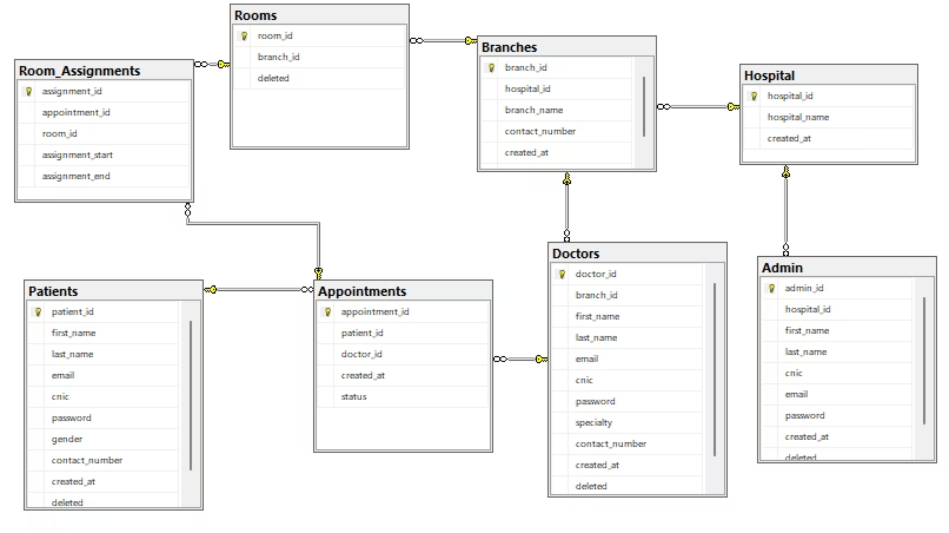
Comprehensive Database Design

Slide 5






Streamlined Operational Workflow
Admin Registration
Register administrators at each hospital level for oversight.
Branch Creation
Establish new hospital branches with unique identifiers.
Doctor & Room Setup
Allocate doctors and rooms to specific branches.
Patient Registration
Onboard patients with comprehensive health records.
Appointment & Room Assignment
Automate scheduling and resource allocation.
Report Generation
Generate detailed reports for performance analysis.

Slide 6






Core Features: Part 1
User-Centric Login
Patient-Focused Appointment Tracking
Doctor-Focused Appointment Tracking
Room-Focused Appointment Tracking
Deletion of Accounts Result in appointment cancellation
Room Utilization Management

Slide 7





Core Features: Part 2
Branch Level Report
Room Level Report
Patient Activity Report
Doctor Activity Report
Export Functionality
Proper Error handling

Slide 8



Key DBMS Features Utilized
30+ Stored Procedures
4 Triggers
Clustered & Non-Clustered Indexing
Optimizing query execution and encapsulating complex logic.
Automating actions and enforcing data integrity rules.
Accelerating data retrieval and improving query performance.
Normalized Database Design
Transactions
Minimizing data redundancy and maximizing data integrity.

Slide 9
Project Demo

